Slide 1
We make hot joints.

Slide 2
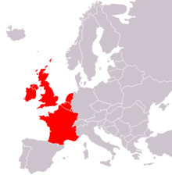
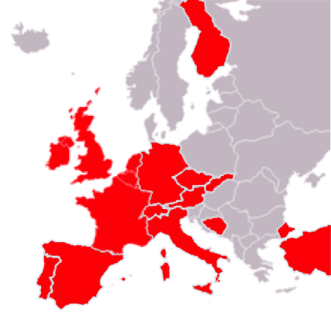
Who we are.
Originally part of a leading international handheld repair and rapid prototyping company, Repair point was formed*
as an independent European based contract provider of electronic repair services, with a unique combination of service and technological capabilities.
* in 2009

Slide 3
What we do.
We specialize in the repair of high technology, high mix, low to medium volume and complex electronic products
where product quality and long term reliability
is a key requirement.
Design feedback, quick repair turnaround
and close working relationship is our norm.
Diagnostics and Testing: JTAG boundary scan, JTAG flashing, Wifi, Bluetooth testers, GPS simulator,
full test development Repair: contract repairs, components and BGA replacement, BGA reballing,
Track and pad repairs. Hardware and firmware update Prototyping: concept design, pcb layout,
design for manufacture (DFM), mechanical design, design approval, prototype builds(production)

Slide 4
What we do differently?
We are amazingly curious.
We HAVE to discover what caused problem.
Complexity is a challenge for us.
We keep trying until it is solved.
We preserve knowledge and feedback.
So we can solve problems more quickly.
as of 19 Oct 2012

Slide 5
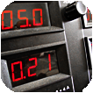
We exactly know where the problem is.
Problem diagnostic
Based on our extensive experiences and technology equipment, we are capable to offer you quick and exact support during solving of your difficult design and quality faults
Discover what is the fault cause
Investigate why do faults occur
Fix faults
Our service department is equipped with
latest diagnostic tools like JTAG, Boundary scan,
GPS simulator, shielding chambers for RF testing.

Slide 6
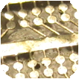
Do you think that board is lost?
Not always.
PAD and track repair
Repair point know high effective method
how to replace damaged or missing circuits
on the printed circuit board surface.
We can replace
All the common thickness, length and width of tracks
All common and custom solder pads

Slide 7
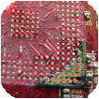
What others know we know better
Surface mount & Through hole component rework
We use a mix of convection and conduction techniques according related IPC standards to force your products run.
Our high experienced staff in combination with
infrared/ hot flow reworks
conventional and microwaves solders irons
can offer you best performance and quality.

Slide 8
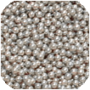
Must BGA component be disposable?
Does not have to be.
BGA reballing
We have advanced* BGA rework systems and a fully trained
staff to support your requirements. This combination provides
you with a repeatable process with every project, meeting
the highest quality standards.
* infrared Vac
Whether you have one board or thousands of boards to rework. We are the company to turn to
for BGA rework services.

Slide 9
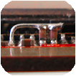
Your designers changed their mind again?
Circuit cuts & Jumper wires
Engineering changes often require component leg lifts or the isolation of circuit patterns. If your circuit board requires such modifications, we can do it.
Completing this task on today's dense and complex circuit board designs is challenging. Our team of technicians are experts at these difficult rework processes.
We have precision milling systems that provide pinpoint accuracy and exact depth control when
cutting surface and internal circuits in dense areas.

Slide 10
Be on track anytime.
RMA management capability
We believe each customer requires individual approach and support.
That's why we have built robust RMA system:
Actual device status tracking
Warranty and various service options tracking
Customizable mail notification
Full root cause analysis with financial viability of each repair
Fault reporting integrated to customer formula
Full material consumption tracking

Slide 11
Let’s make hot joints together.
+421 2 330 15 330, info@repair-point.com

